Slide 1

Progress Report 1: Dual-Mode Real-Time Cap Sorting System Using Arduino Uno
Navarro, Rod Geryk C.
CPE161P-4– C1

Slide 2
OBJECTIVES
Develop a dual-mode sorting system
Create a sorting machine that can operate in two modes:
• Automatic Mode: Sorts caps automatically based on their color.
• Manual Mode: Allows the user to control sorting through a 4x4
keypad.
• Integrate servo motors for sorting operations
Use two servo motors to:
• Pick caps from the storage and position them for color detection.
• Route the identified caps to their respective containers.
• Implement color detection system
Use a color sensor to identify and sort three different colored caps
accurately.

Slide 3
OBJECTIVES
• Display sorting information on an LCD
Show the number of caps sorted per color on an LCD screen in real time.
• Ensure smooth user interaction
Allow users to easily switch between automatic and manual modes
at the start using the keypad.
• Achieve efficient and accurate sorting
Make sure the system sorts caps correctly and keeps track of the
count without errors.
• Test and optimize system performance
Evaluate the system's speed, accuracy, and reliability in both
modes, and make improvements as needed.

Slide 4
DISCUSSION
This project focuses on building a real-time sorting machine using an Arduino Uno. The machine is designed to sort plastic bottle caps based on their color. It has two modes of operation: automatic and manual. In automatic mode, the machine sorts the caps on its own, while in manual mode, the user controls the sorting process using a 4x4 keypad. At the start of the project, the user can choose which mode to use.

Slide 5
MATERIALS
Arduino Uno the main microcontroller to control all components.
• 2 Servo Motors
• Color Sensor (e.g., TCS3200 or TCS34725) Identifies the color of
each cap.
• LCD Display (16x2) Displays the number of caps sorted per color.
• 4x4 Keypad Allows manual control of the sorting process.
• Colored Caps (3 Colors) The items to be sorted (e.g., red, green,
blue caps).
• LEDs (Optional) Indicate different states like sorting status or
errors.
• Breadboard For circuit assembly and prototyping.
• Sorting Containers (3 Pieces) Separate containers for each color.
• Power Supply (5V or USB) To power the Arduino and components.
• Laptop with Arduino IDE For programming and uploading the
code

Slide 6
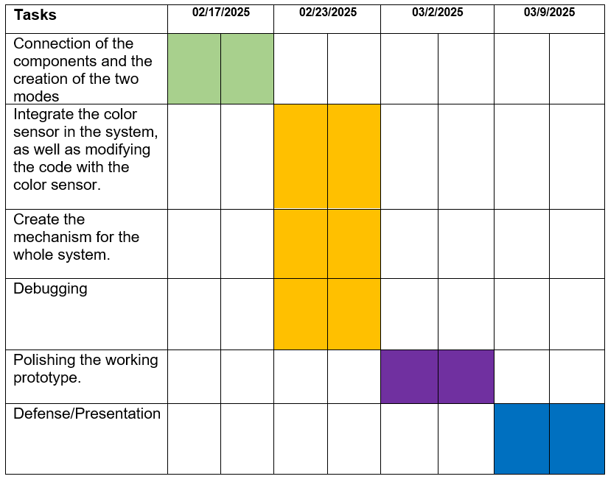
PROCEDURE

Slide 7
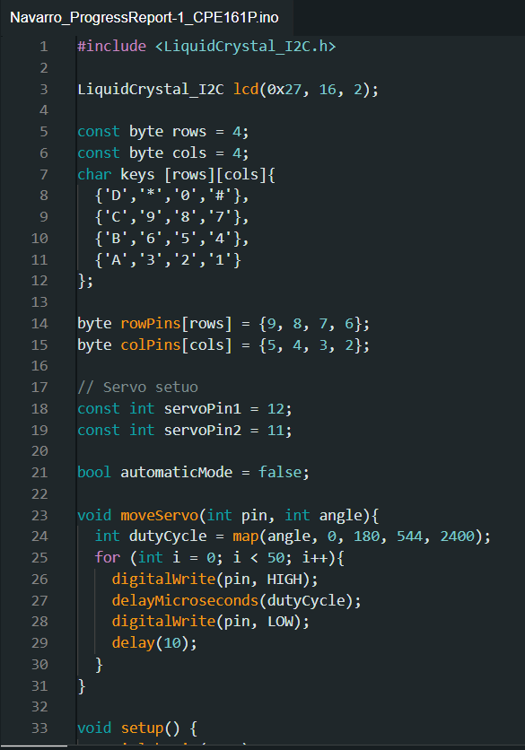
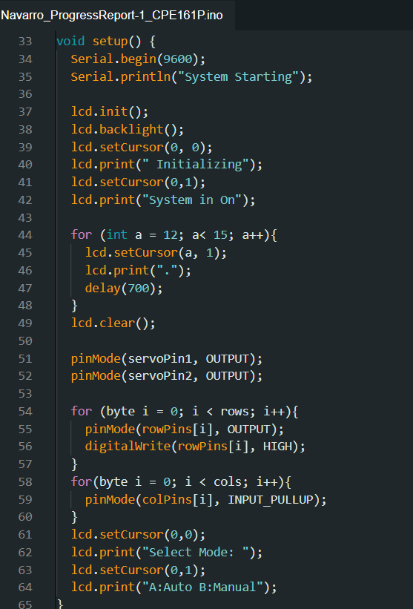
CODE

Slide 8
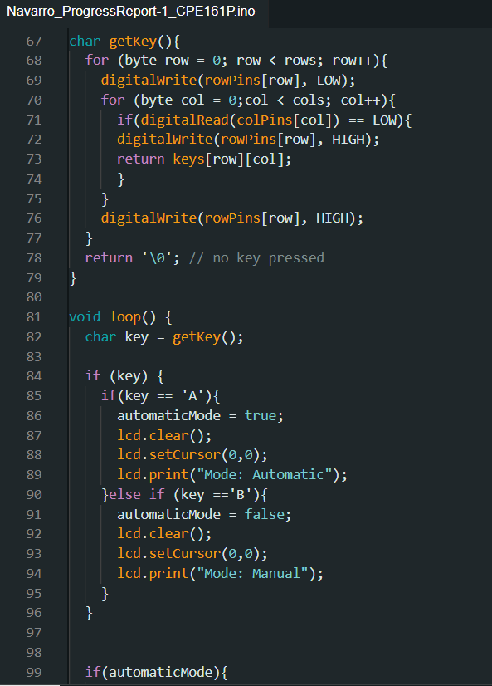
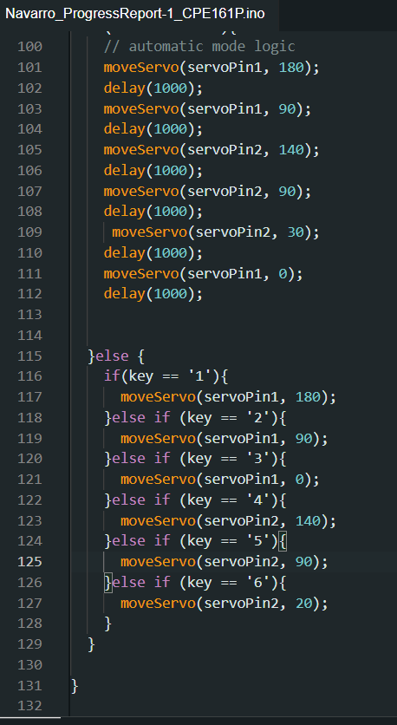
CODE

Slide 9
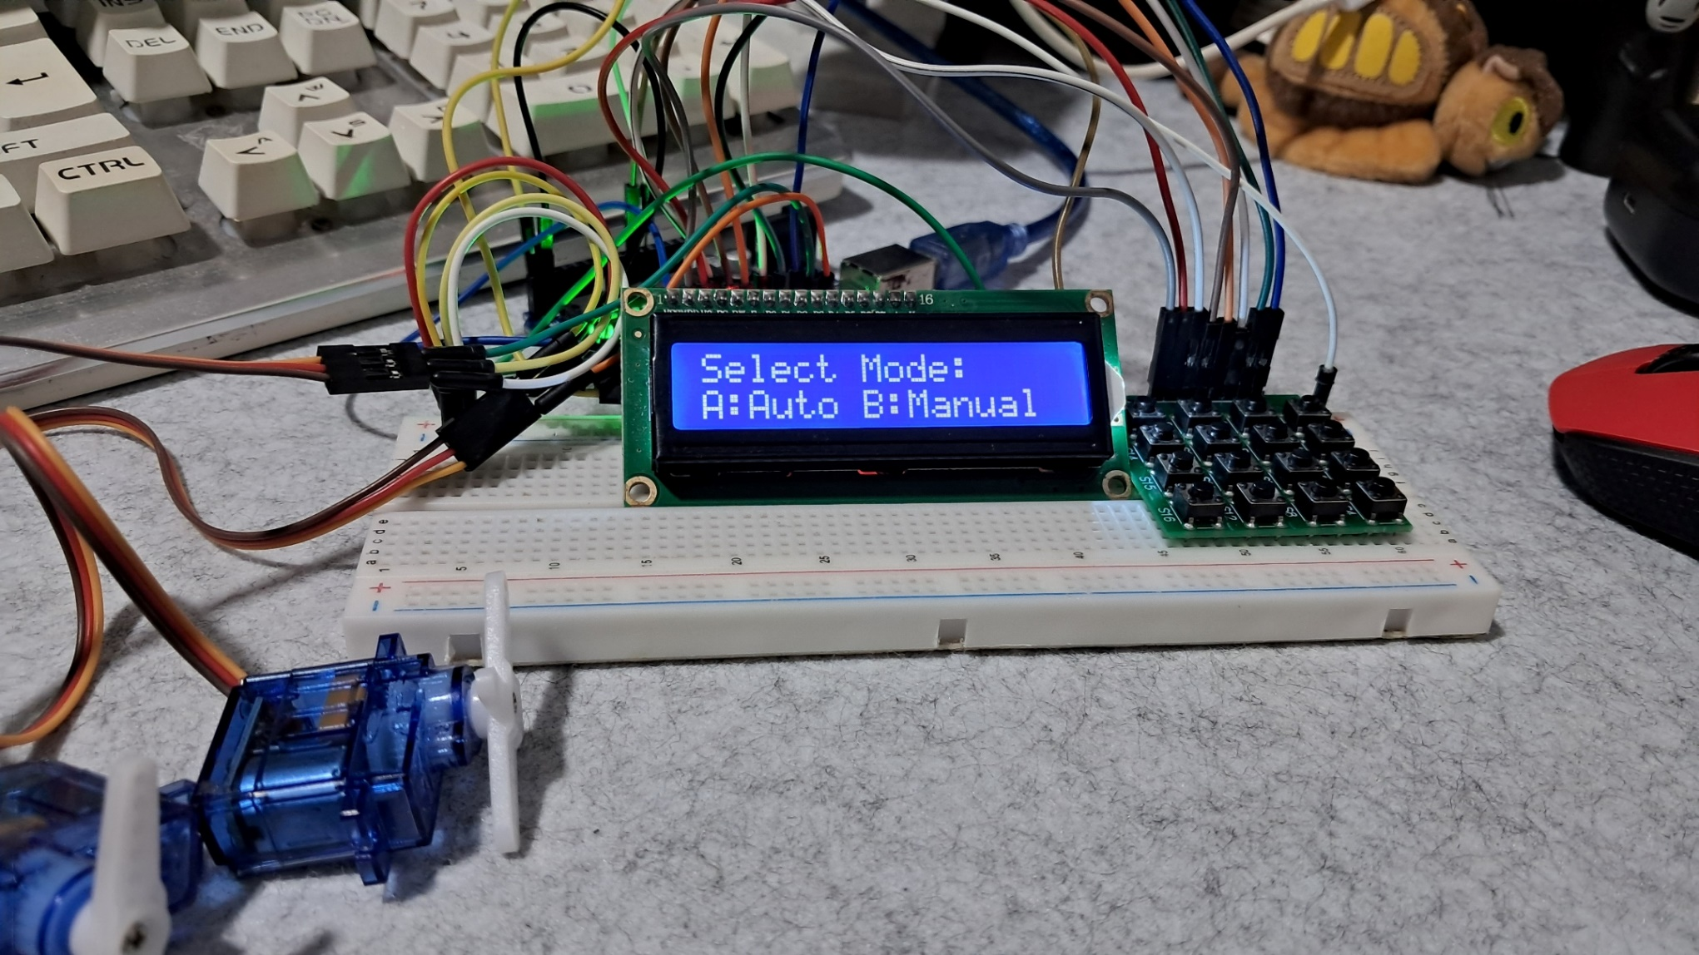
Final Output

Slide 10
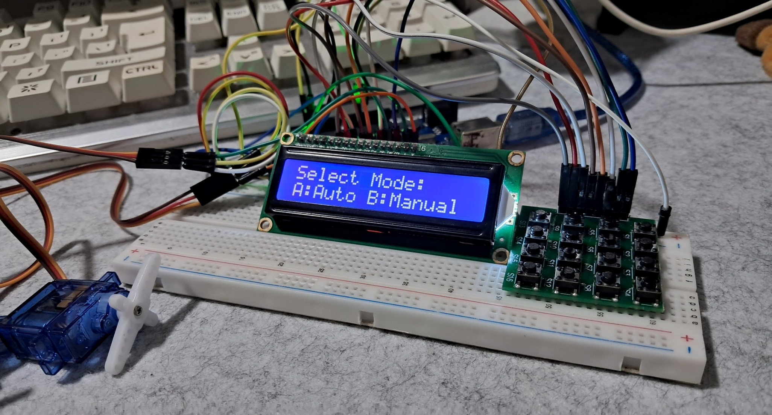
Final Output

Slide 11
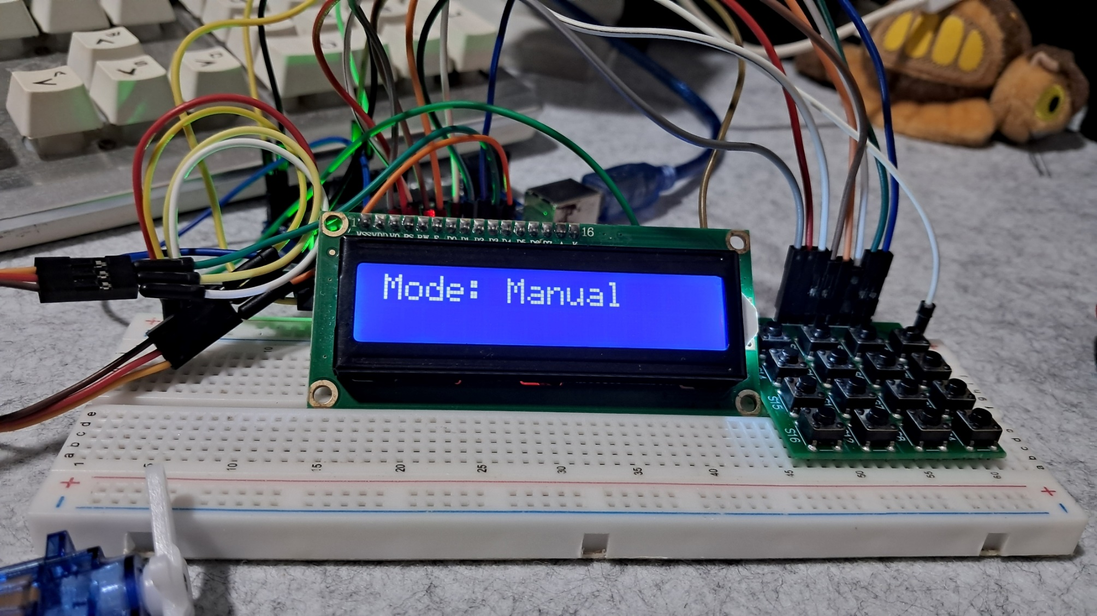
Final Output

Slide 12
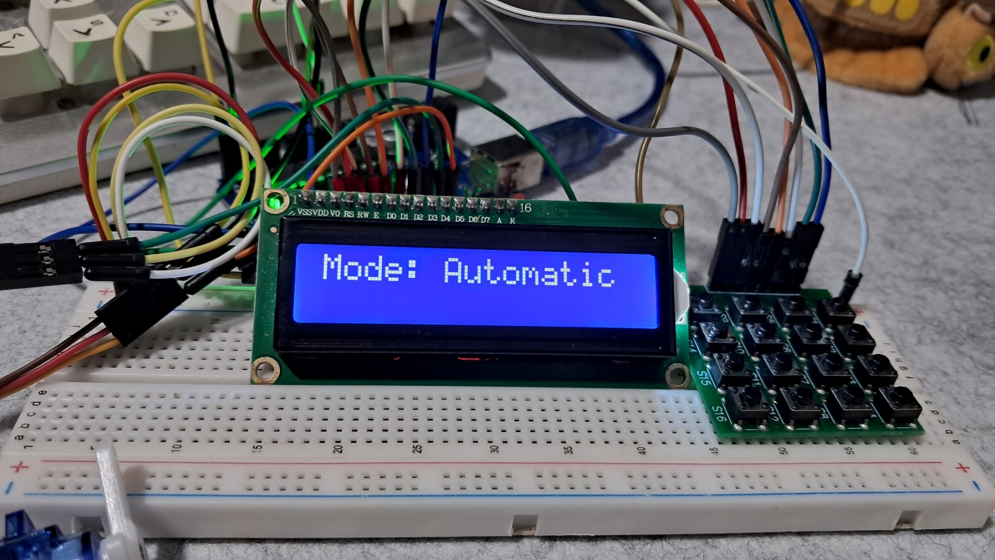
Final Output

Slide 13
THANK YOU!

